Slide 1

Housing Price Prediction Model
Kelvin Chow

Slide 2
Objective
Help home buyers to obtain an immediate estimation of the property price

Slide 3
Agenda
Data Exploration
Data Pre-processing
Models Evaluation
Application

Slide 4




Tools

Slide 5
Data Exploration
Housing prices from Ames, Iowa
1,458 Observations, 80 Features
Floor area, Neighbourhood, Garage, Basement
43 categorical features
15,417 null values

Slide 6
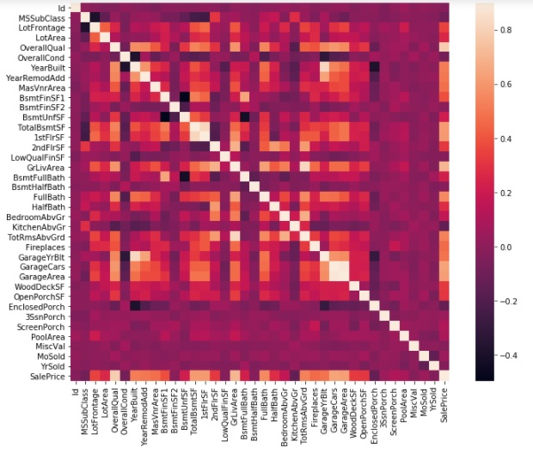
Data Exploration

Slide 7
Data Exploration
Overall Quality
Floor Area
Garage Size
Sale Price

Slide 8
Data Exploration
House Year Built
Garage Year Built
Floor Area
No. of Rooms
Garage Cars
Garage Sqft

Slide 9
Data Preprocessing
Fill Null values
House width using Neighbourhood
Add “None” as a category for no pavements
For houses without garage, size ,type and quality
Label encode 28 categorial columns
One hot encoding the rest

Slide 10
Data Preprocessing
Feature Engineering
Convert year of built to age of house
Convert year renovation to age of renovation
Sale for month and year were combine and made relative to last date entry.

Slide 11
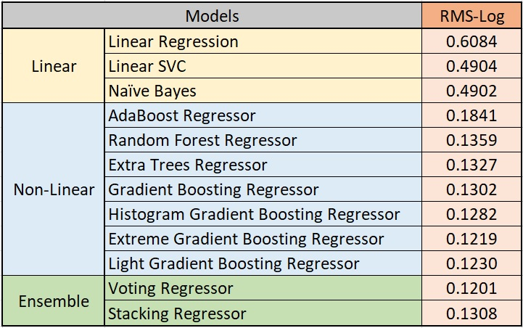
Models
Standard Scaling
Hyper-Parameters
RandomizedSearchCV
GridSearchCV

Slide 12

Models

Slide 13
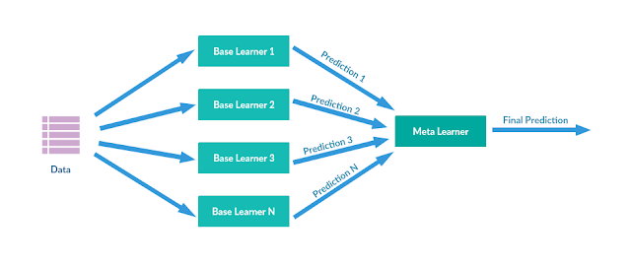
Models

Slide 14
Models

Slide 15
Models

Slide 16
Models

Slide 17
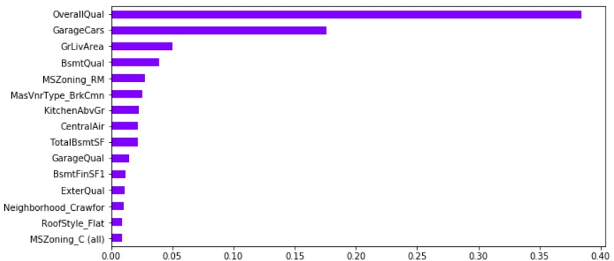
Feature Importance

Slide 18
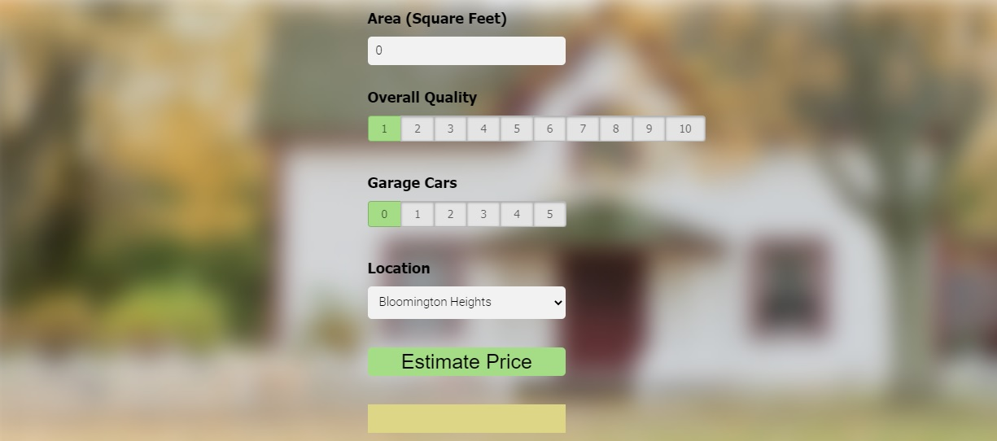
Application

Slide 19
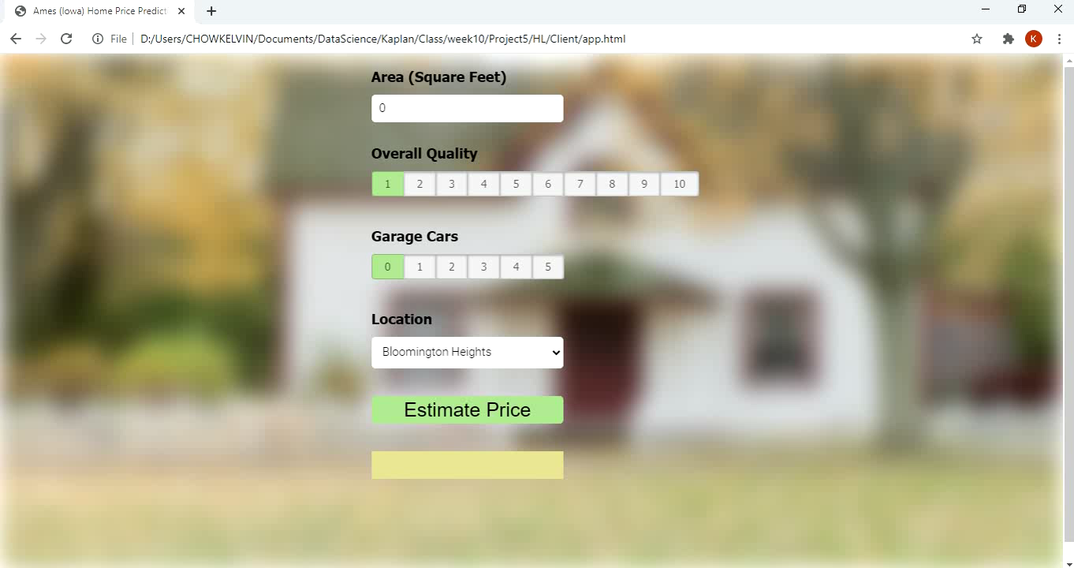
Application

Slide 20
Conclusion
Home buyers can now get a price estimation of the properties they are interested in
If seller over-priced and refuse to reduce…
If seller under-priced, it’s a bargain

Slide 21
Future Works
Housing prices prediction model can still be improved further
Feature engineering
Hyper-parameters tuning

Slide 22


Kaggle

Slide 23
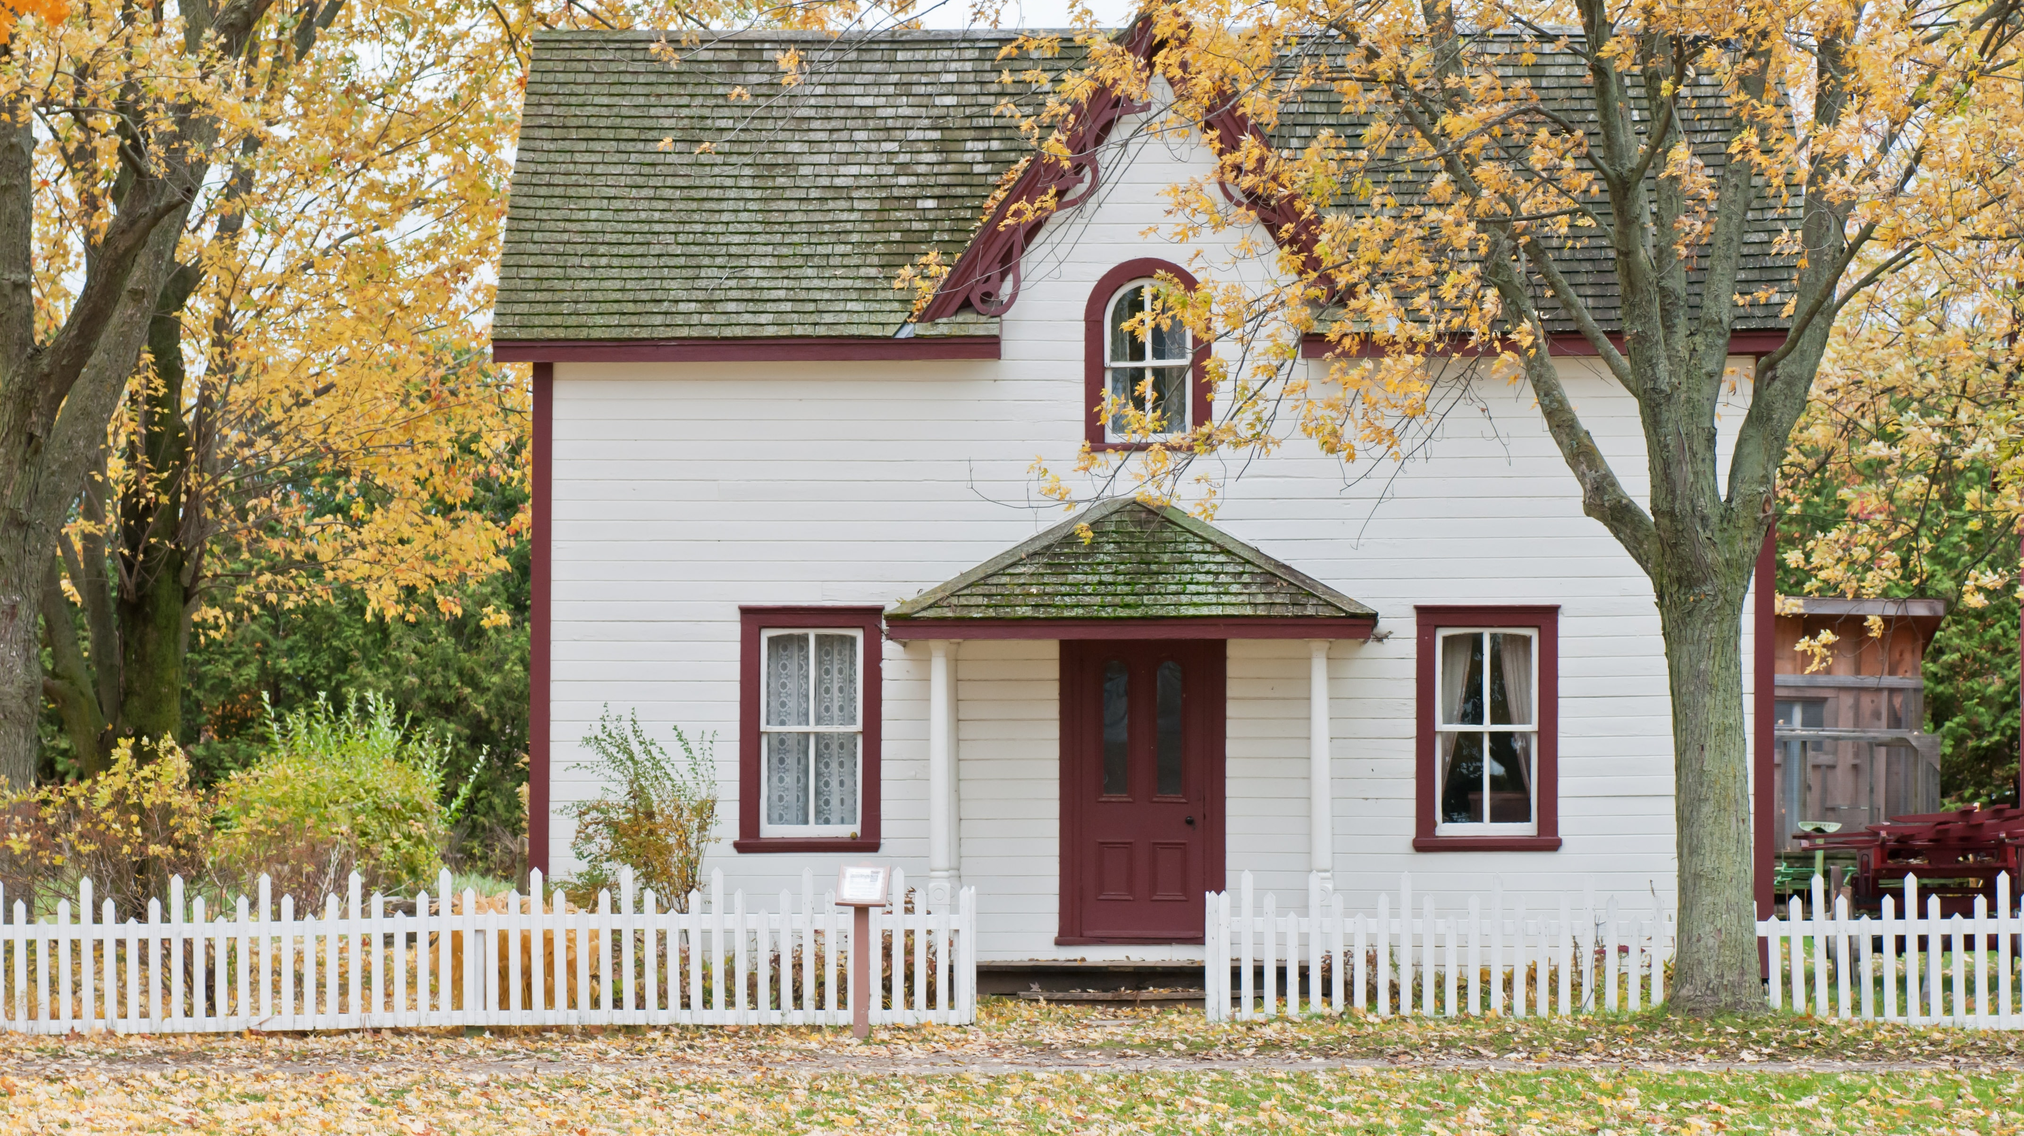
Thank You
Kaggle: https://www.kaggle.com/kelvinchow1979
LinkedIn: https://www.linkedin.com/in/kelvin-chow-3a8b678/
Medium: https://medium.com/@kel_line
GitHub: https://github.com/Kelvinchow79

